Slide 1
Consultations at Essex CC
Member Development Session
Paul Turner, Director, Legal and Assurance
Sean Marks, Researcher, Strategy, Insight and Engagement
Notes:
Intro by Paul

Slide 2
Today we will cover…
Notes:
Outline by Paul

Slide 3
What is consultation?
Consultation is
a recorded two-way communication
with service users, providers or a section of the public
to find out their views on a specific proposal or decision
so that their views can inform the final decision.
Notes:
If we are doing all these things then it is consultation and the law applies.
Sometimes we do research about what people thing about our services or how they are used without asking for their views on a particular proposal. That is not consultation and it’s sometimes called engagement.

Slide 4
When do we have to consult?
A specific law says we must
We are proposing to close/change a service
There is a history of consultation on an issue ‘legitimate expectation’.
If we want to find out what people think.
Notes:
Paul
Even if we think we know what people think, actually we may know people will not initially be keen, but consultation lets us know the impact that people say things will have, and also how strong opinion is.
Sometimes we have to consult because there is a specific rule in legislation saying we must (traffic orders, budget consultation)
Sometimes we are proposing to do something that people won’t like and means people will lose something or access to something. The law says that we have to consult so that we can know the impact. Sometimes there are simple things that we can do to reduce the impact.
Sometimes there can be something we have always consulted upon so people will argue that they have the right to be consulted on it because we always have.

Slide 5
Legal Rules
Consultations must:
Be undertaken at a time when the proposals are at a formative stage
Be accompanied by enough information to enable people to give an informed response
Be open for sufficient time to allow people to respond
Be taken into account by the decision maker
These rules apply to all consultations, even if they are voluntary.
Notes:
These are the legal rules about consultation.
They apply to all consultations. If we consult – even if we didn’t have to - and don’t follow these rules then the decision based on the consultation could be quashed by the courts.
So there are FOUR elements which every consultation must meet:
* Formative stage. All it means that if you make a decision and then find out what people think about it afterwards then that’s not consultation.
Enough information – This will depend on the proposal. Policies- draft policy – Service changes- explain why and what the proposed alternatives are.
Enough time – six weeks is generally enough, less may be OK
Be taken into account – all issues must find their way into consultation

Slide 6
What the law does NOT say
Law is not generally interested in questions
The most important thing is that people have the opportunity to say what they want to say
Don’t have to consult on specific options (but you can)
Don’t always have to consult
Law doesn’t regulate ‘fact finding’ – because that is not consultation
Notes:
The most important thing is to ask on the right issues.

Slide 7
Consultations on Policies
Policies are complex documents
There are no special rules on consulting on policies.
In practice we publish a draft policy which is proposed to be adopted.
Even though policy is draft and it has been agreed to consult on it, it is not a policy unless it has been adopted after the consultation.

Slide 8
Making a decision
Not a referendum or a vote.
Points raised in consultation must be taken into account
Decision maker must know what’s been said.
Further consultation?
Notes:
Not a vote, so it doesn’t matter that most people say they are opposed. People sometimes say ‘we know people won’t like it’ or ‘what will we do if everyone says they won’t like it. My response is that we don’t know strength of feeling and we don’t know the impact and it is right that a decision is made having regard to impacts
It is not the exact words that need to be drawn to the attention, but the issues raised, so that points raised can be considered. These would include
Potential Impacts/severity
Suggestions for avoiding the impact

Slide 9
Decisions to consult
Are not key decisions
Can be taken by officers or Councillors
Cannot be called in

Slide 10
Consultation process
Survey/Questionnaire

Slide 11
Consultation Survey/Questionnaire
The purpose of a consultation questionnaire
Councils sometimes have a statutory requirement to consult their residents over issues such as planning, redevelopments or service change.
Statutory consultations are bound by legal requirements,
Notes:
The purpose of a questionnaire is to collect feedback from relevant groups and stakeholders in a local community or council on a range of key features (vision, ethos, strategies, statutory service change etc.)
This will be due to something changing within current service delivery
Legal requirements such as Best Value legislation, and can have strict rules surrounding how they should be conducted.

Slide 12
Consultation Survey/Questionnaire
Before we run any consultation exercise, it’s important to make sure that it is a necessary activity.
Consultations can be time-consuming for councils to run,
People can get confused and frustrated by councils undertaking apparently similar consultations at, or near, the same time.
Notes:
We as an authority need to understand if we need to actually consult.
Consultations while asking residents for unnecessary information can be a waste of time and resources, as well as being annoying for the people asked to take part.
You are likely to increase the number of responses you receive if you reduce ‘consultation fatigue’.

Slide 13
Consultation Survey/Questionnaire
It is unrealistic to think you can consult everyone about everything.
The survey/questionnaire should serve purpose to provide evidence about proposals being put forward
Various other forms of data captured (Number of service users, Evaluation of service etc) can contribute to the overall consultation
Notes:
But you should strive to achieve a representative cross-section of views to ensure that you understand differing views within the community
and should include questions that directly relate to this.
so respondents can feel they have enough information to make an informed decision for that particular consultation

Slide 14
Asking the right questions
When designing questionnaires to help support a consultation activity we should
Be absolutely clear about the objectives of the survey
Review previous questionnaires
Are there any budgetary considerations?
Will the respondents understand what you are asking?
What could you ask for each of your objectives?
Get key stakeholders involved
Identify key questions, what do you actually want to know? Show how each question links to a specific objective
Major structural divide? - consider two questionnaires (differences between to different respondent types - Residents vs Businesses)
Look at the survey from different points of view
Think about what could potentially be misinterpreted
Pilot the survey and Use the results to make improvements
Notes:
What decisions are you trying to make?
What information do you need to know?
What has worked well or badly in the past?
How will feedback help stakeholders make decisions?

Slide 15
Asking fair questions
There are two types of questions that can be asked open questions and closed questions.
Open format questions are those that ask for unprompted opinions. In other words, there are no predetermined set of responses, and the participant is free to answer however they choose.
Closed format questions usually take the form of a multiple-choice question. They are easy for the respondent and are easier to be analysed once the questionnaires are returned.
When designing surveys/questionnaire to accompany consultations we need to consider the following:
Clarity - Questions must be clear, succinct, and unambiguous. The goal is to eliminate the chance that the question will mean different things to different people. It is best to phrase your questions empirically if possible and to avoid the use of necessary adjectives.
Leading Questions - A leading question is one that forces or implies a certain answer. It is easy to make this mistake in formulating the question as well as the choice of answers.
Phrasing - Most adjectives, verbs, and nouns in English have either a positive or negative
connotation.
Prestige Bias - Prestige bias is the tendency for respondents to answer in a way that make them feel or look better.
Questionnaire length - There is no consensus on how many questions should be asked but an overly long questionnaire will lose the respondents attention and may result in a lower response rate.

Slide 16
Asking fair questions
How we plan our consultation survey design
Formulate a plan for doing the statistical analysis during the design stage of the project.
Provide a well-written cover letter.
Include clear and concise instructions on how to complete the questionnaire.
The wording of a question should be simple and to the point. Do not use uncommon words or long sentences.
Leave adequate space for respondents to make comments.
Place the most important items in the first half of the questionnaire.
It is important to group items into coherent categories.
Make it convenient. The easier it is for the respondent to complete the questionnaire the better.

Slide 17
Why do we collect demographic Information within a consultation?
Demographics are characteristics of a population and serve purpose around evidence gathering within consultation process (Help with impact assessments).
Characteristics such as race, ethnicity, gender, age, education, profession, occupation, and marital status, are all typical examples of demographics that are used in surveys
Choosing demographic questions will truly give the council actionable and meaningful results to assist in making better business decisions.
Examples of Demographic questions
What is your Age?
To which gender identity do you most identify?
What is your marital status?
What is your sexual orientation?
What is your religion/faith?
What is your ethnicity?

Slide 18
Survey design regarding demographic questions
4 Tips on How to Use Surveys to Get Valuable Demographic Information
Make it anonymous. The fact is, many people are cautious about revealing information they consider private. In case your survey is anonymous, make sure to emphasize that.
Briefly explain the background of your survey. Include a brief introduction to your survey in which you would clearly state its purpose. Reassure your respondents by sharing exactly how you’ll be using their information.
Make it easily accessible and Inclusive. As we live in a digital world, you need to make sure your survey is available to be filled out online and hard copies.
Make it brief. Shorter surveys are easier for respondents to complete.

Slide 19
Consultation platform
https://consultations.essex.gov.uk/

Slide 20
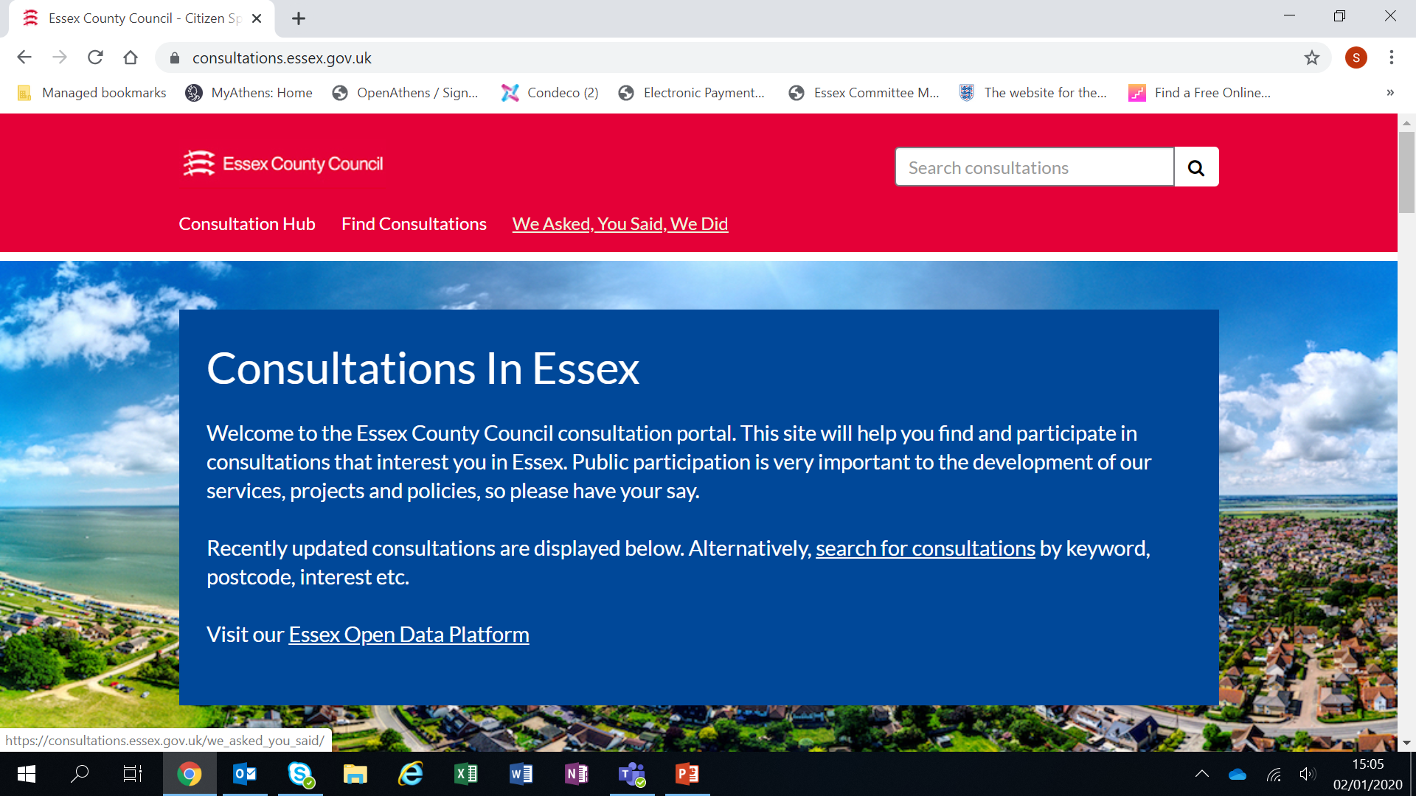
Consultation platform

Slide 21
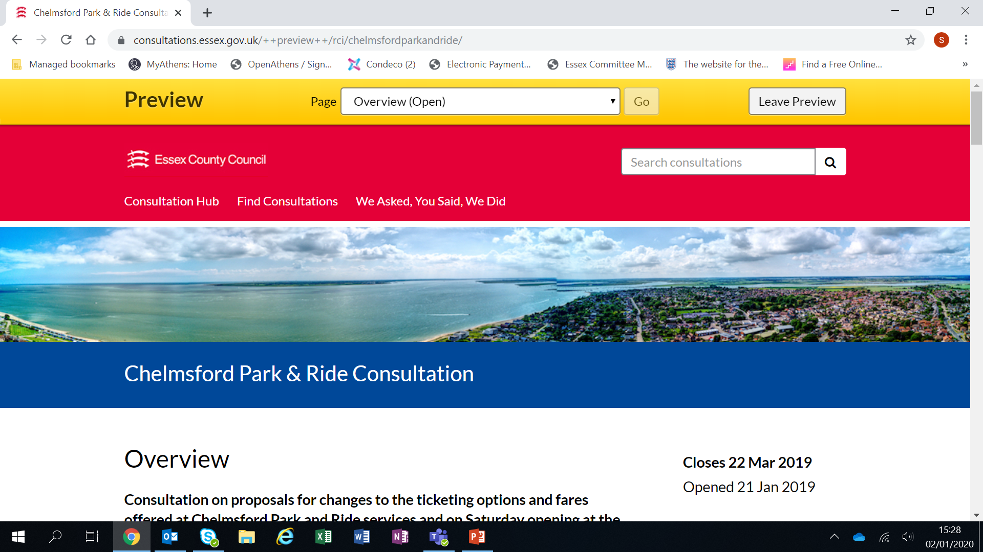
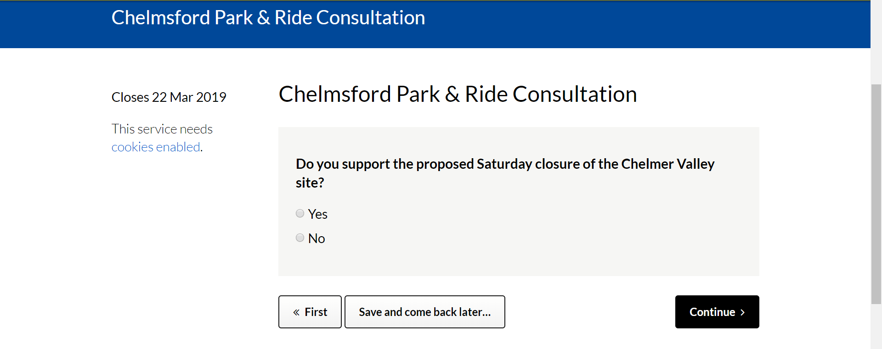
Consultation platform
Consultation example

Slide 22
Questions?
Notes:
Paul/Sean

