Slide 1
Your Police engagement during covid-19
Insights and learnings

Slide 2
Our team
Davina Research & Insights Manager
Hamish Insights & Engagement Officer
Darren Insights & Engagement Officer
Eve Insights & Engagement Lead

Slide 3
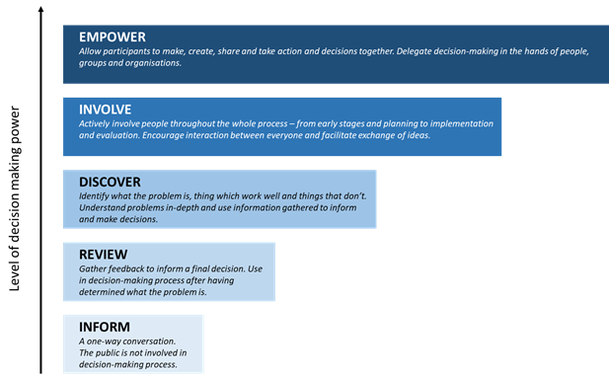
Contact & Engagement Strategy Engagement Framework Collaborative research with Victim Support Scotland Citizen Space management User Experience Surveys Public engagement and consultations

Slide 4
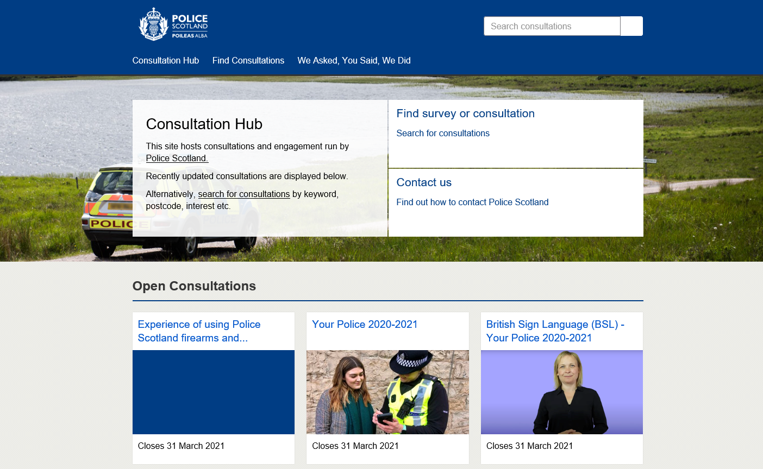
Officially, we moved to Citizen Space on 12 August 2019
6 public surveys & engagement
Over 49,500 responses
Over 500% increase in engagement

Slide 5
Top surveys
Survey on Police Scotland Football Engagement Strategy - 6,817 responses
Children and Young People engagement - 1,609 responses
Your Police 2019 - 11,656 responses
Your Police 20/21 (ongoing) - 27,712 responses
Consultation on Police Joint Strategy - 1,452 responses

Slide 6
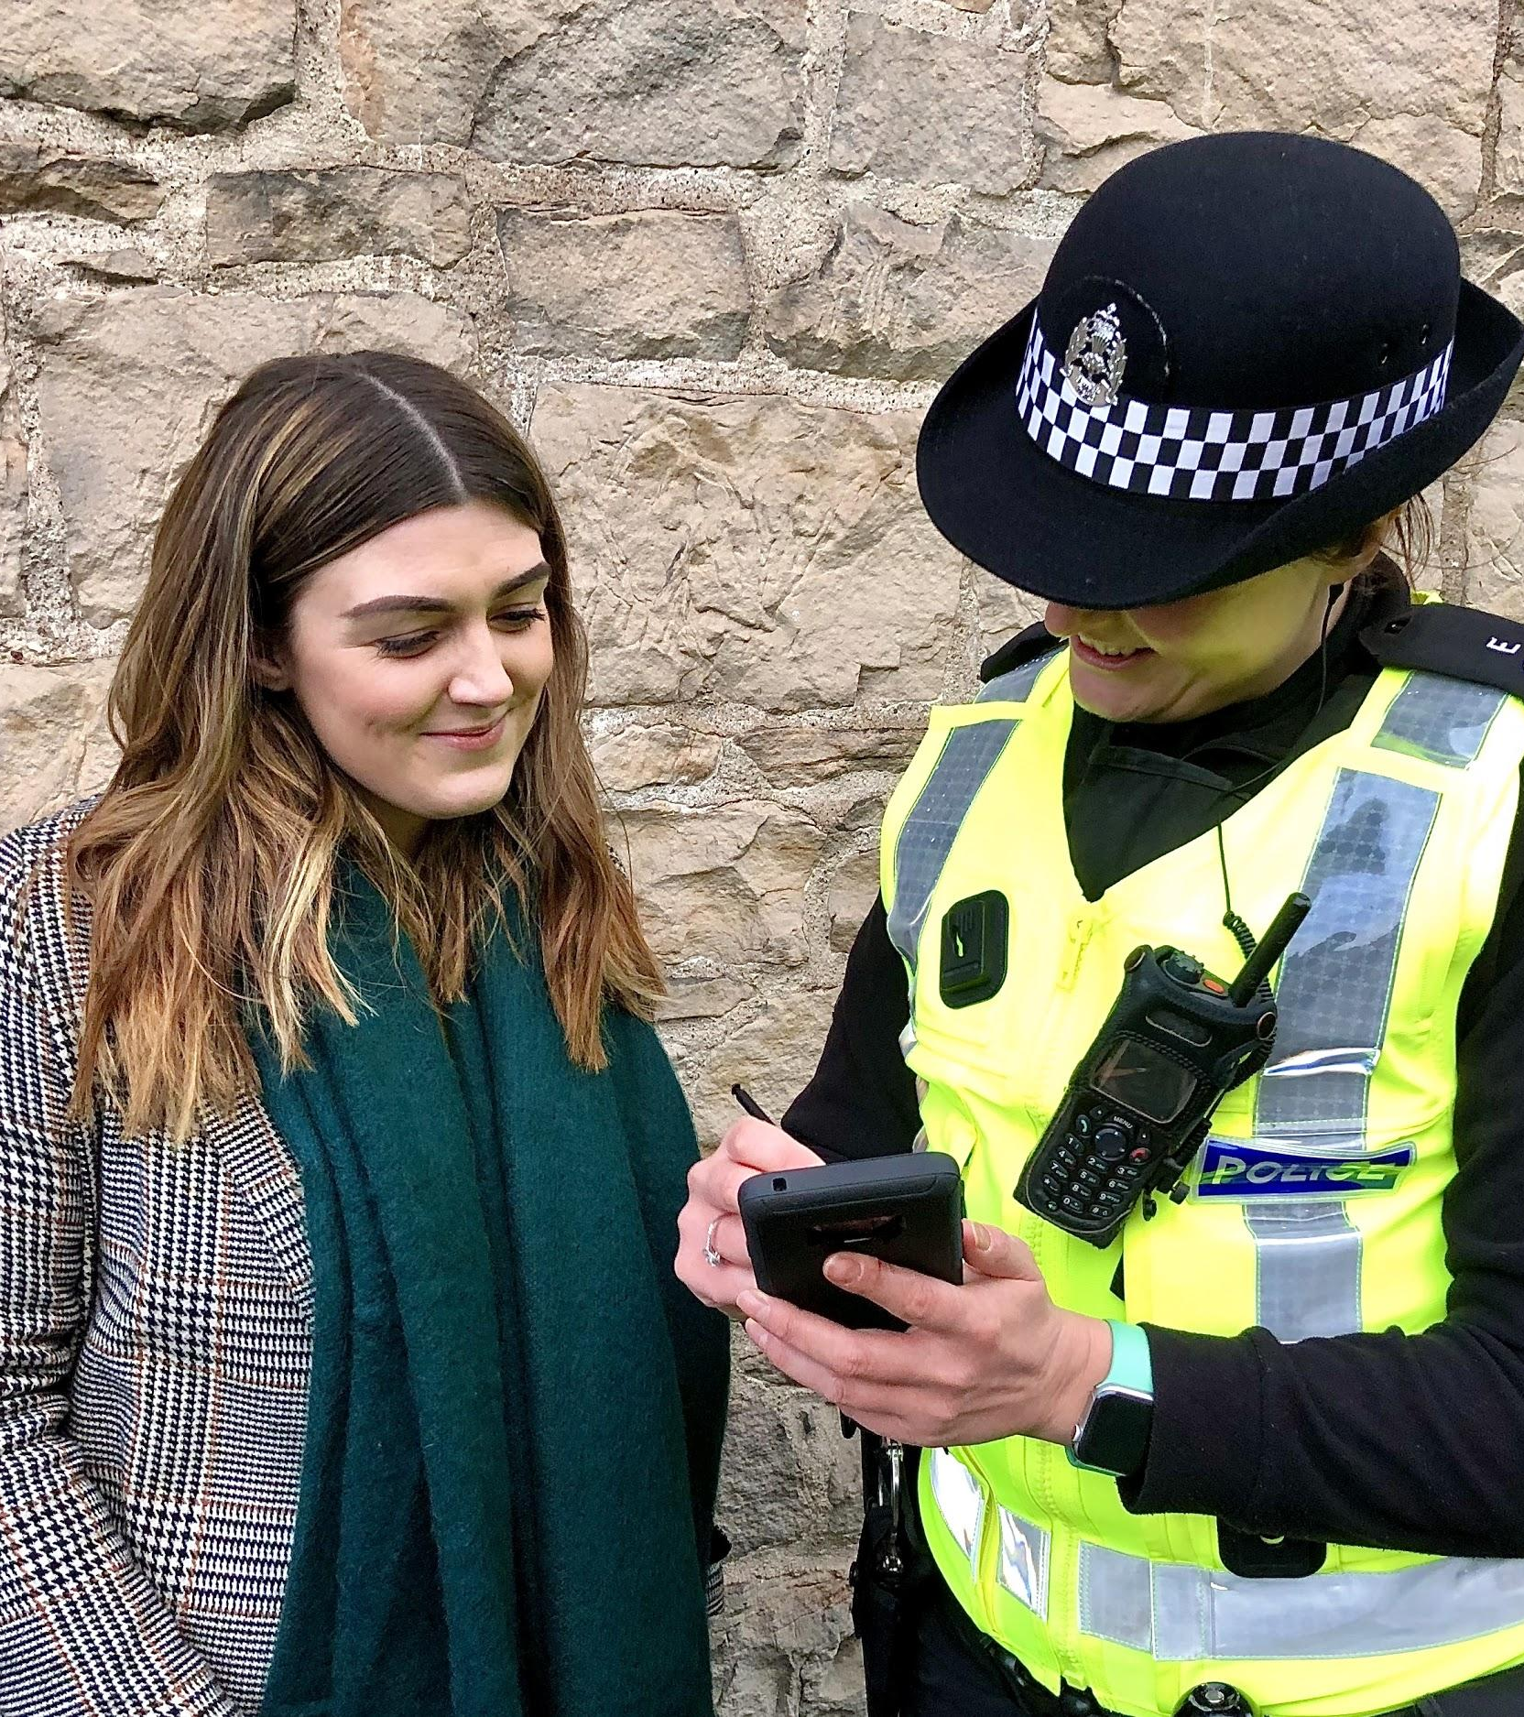
Your Police survey context
Previously ran yearly surveys called Your View Counts
Refreshed survey pilot ran Nov-Dec 2019
Review learnings from pilot
Replaced previous yearly survey with Your Police in April 2020
Survey launched during covid-19
Additional question included to gain understanding of experiences and views of new police powers and activities.

Slide 7
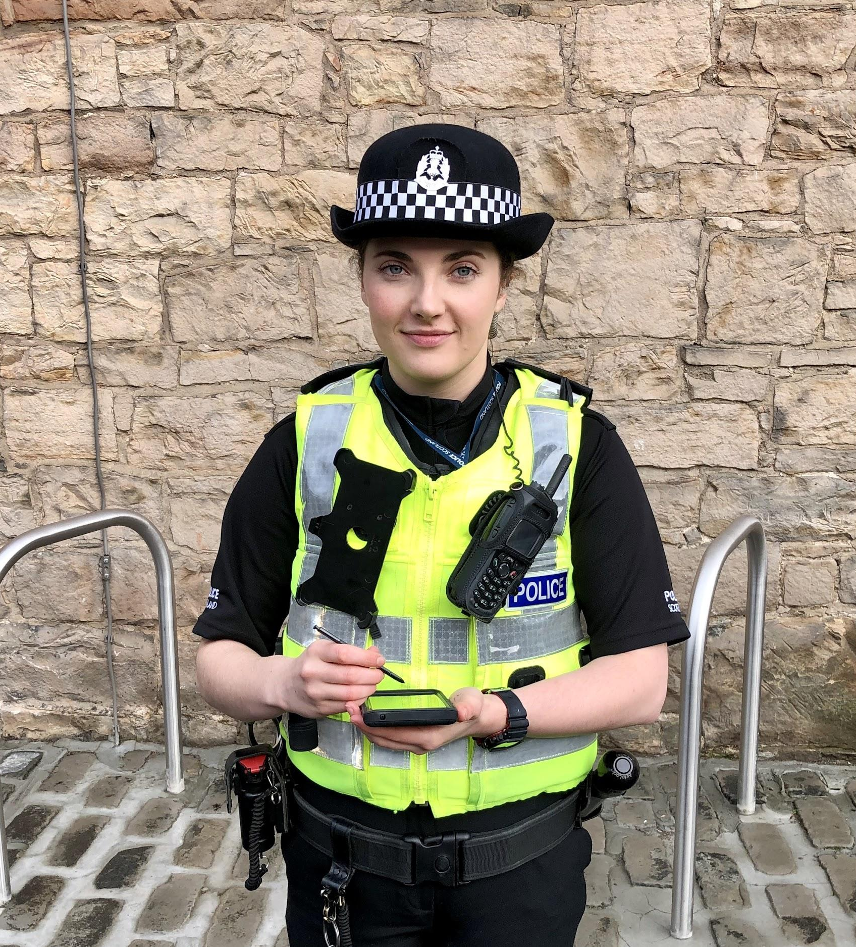
Launching a survey during covid-19
Crucial to measuring public confidence & experience of police services during this time
Analysis conducted on weekly basis
Reporting to main Covid police operational boards, Executives and Scottish Police Authority
Extensive reporting and analysis including sub-group analysis
We found out that public confidence in policing increased during lockdown
It increased by 20 percentage points.

Slide 8
Our actions based on insights
Creation of Police Scotland Public Confidence Board
Analysis reports contribute to different business areas and police operations
Enhancing local police presence at identified locations
Focused and targeted engagement with those groups less represented in the survey
Increase engagement with over 20 organisations representing the interests of disabled people
Include the needs and circumstances of vulnerable people in daily Police officer briefings
Improve public information and advice at national and local level regarding Coronavirus
https://consult.scotland.police.uk

Slide 9
What worked well
Survey accessibility - Easy Read, BSL, telephone survey
Local police divisions ownership & engagement locally
Refreshed question set
Pilot survey and getting partner feedback
Reviewing the data weekly and monthly
Align key questions to other UK-wide surveys
Triangulate data with other surveys
More people engaged with us during lockdown

Slide 10
How might we…
Analyse 60,000 open text responses?
Streamline qualitative analysis?
Share data and insights efficiently across the organisation?
Enable colleagues across the organisation to explore the data themselves?
Continue to turn public insights into action for frontline officers?
Work with Comms teams at the start of each project?

Slide 11
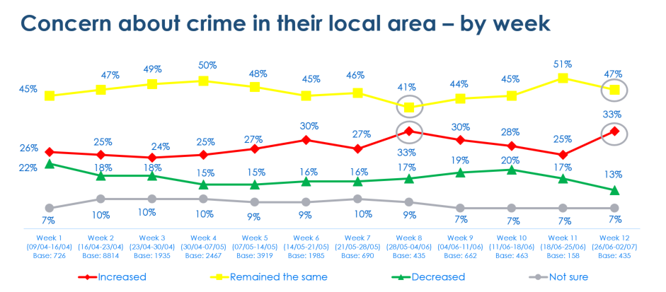
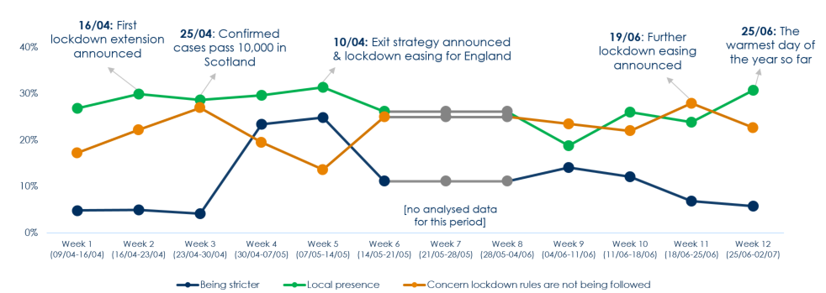
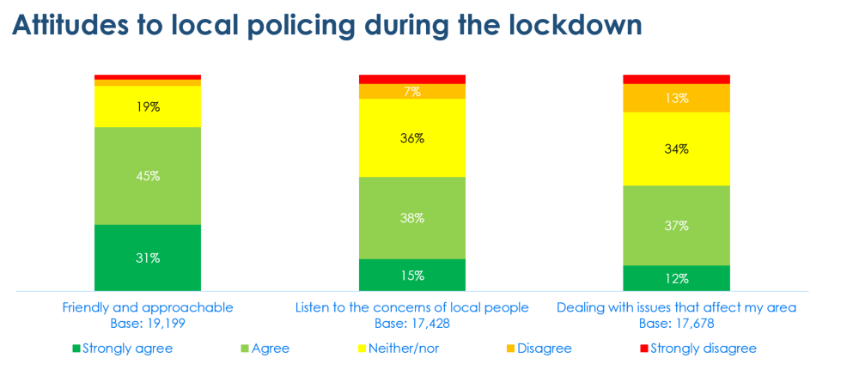
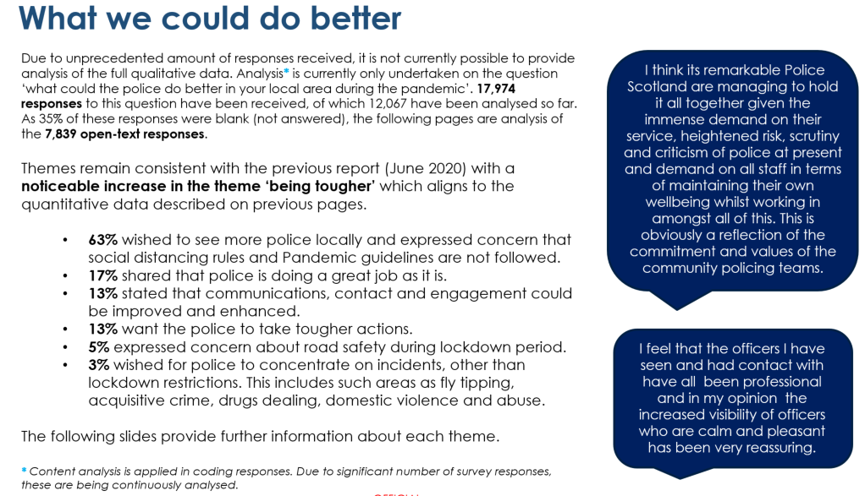
Quantitative data
Qualitative data

Slide 12
Questions?
Reach us via email
consultations@scotland.pnn.police.uk

