Slide 1
Accessibility

Slide 2
What is WCAG 2.1?
Notes:
To ensure everyone can have digital access to your services, your consultations - government and government providers follow the Web Content Accessibility Guidelines (WCAG) which is an internationally recognised standard.
WCAG 2.1 was recently released and includes 17 additional WCAG criteria - WCAG 2.0 was created in 2008.
The additional criteria address accessibility issues when using mobile technology, and ensures services are able to meet the needs of people with low vision and those with cognitive and learning disabilities. They also recognise specific areas of technology advancement and the needs of more diverse users. This includes users who don’t speak English as a first language.

Slide 3
Accessibility is everyone’s responsibility
Notes:
In the UK, 1out 6 people have a disability and in the over 65s, this increases to1 in 2.
The goal is to ensure that regardless of what disability a person has, they are able to access your consultation and achieve a successful digital experience.
Consultations are often designed with the perfect user in mind.
The range in our communities functional abilities is huge
There are degrees of vision and hearing impairment
People's literacy levels and memory vary due to common conditions such as dyslexia, autism, dementia and stress.
Physical ability vary with differences in mobility, dexterity, strength and levels of pain.
If your audience is over 65, then half of them will have some sort of disability.
For people with disability, to effectively engage with your consultation they need accessibility support on their device of choice and content created in a way that supports the needs of people with disability,
For example, why particular functionality in Citizen Space behaves as it does, for example why you can’t change the colour of your questions? Because we have set your theming and have check it for colour contrast issues.
Why is there no in question skip logic? Because this type of automatic page navigation does not for people with cognitive problems.

Slide 4
Can everyone read this?
Notes:
Can everyone read this?
I can read it just fine, But I am not the one that needs to see it, to understand it. And that’s how you need to think when you are creating a consultation. It is about how a respondent reads, interprets and responds and that is up to you.

Slide 5
Assisted Technology
Screen reader: A text-to-speech application that reads information on the screen to assist people who are blind or vision impaired
Screen magnifier: A magnification tool used to enlarge screen content
Themes: High contrast themes allow people with visual impairments to change the colours to a more comfortable setting (such as white-on-black) and increase the size of mouse pointers and text
On-screen keyboard: Enables people with mobility impairments to ‘type’ by using a pointing device to select letters and words on the screen
On-screen alerts: Visual messages can appear in place of audible sounds to help people who are deaf or hearing impaired
Sticky keys: Provides assistance to people with a mobility impairment by allowing keyboard commands to be typed in rather than having to hold down multiple keys to achieve a task.
Notes:
The purpose of AT is to help people with disability overcome difficulties on popular digital devices such as computers, smartphones and tablets.

Slide 6
Accessibility
Notes:
Perceivable: Available to the senses (sight, hearing or touch) either through the browser or through assistive technologies. As an example, if the information is provided as text, someone that has sight needs to be able to see it. If someone has no sight the text needs to be available in a format that means a screen reader can convert it to audio and an electronic braille device can convert it to touch.
Operable: Users can interact with all controls and interactive elements using either the mouse, keyboard, or an assistive device.
Understandable: Content is clear and limits confusion and ambiguity. For people that struggle to process text, which may be the case for someone that has dyslexia or is on the autistic spectrum, the information should be in plain english and aid comprehension.
Robust: A wide range of technologies (including old and new user agents and assistive technologies) can access the content. The web page needs to work as expected across all these devices.

Slide 7
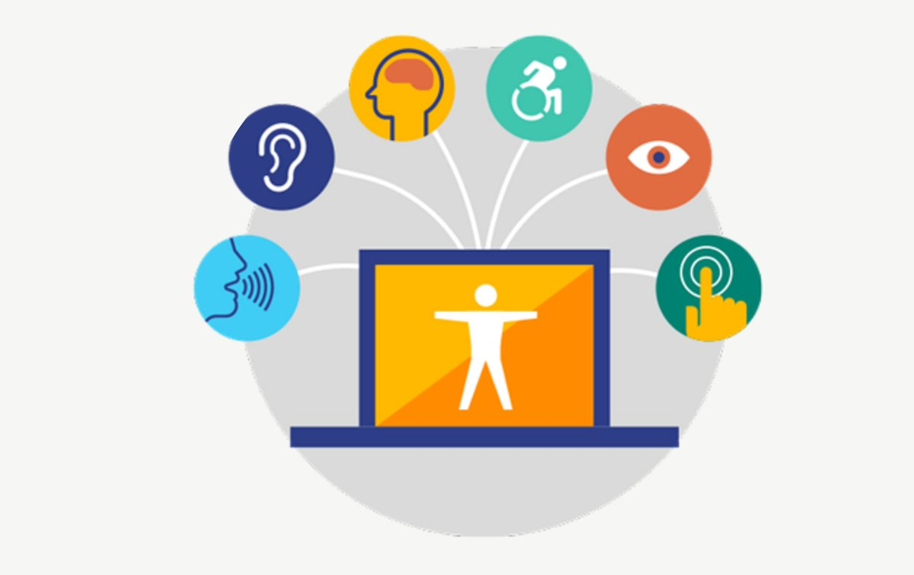
Can everyone read this?
Notes:
There are lots of things, key features in Citizen Space where we have tried to do the hard work for you.
It is fully responsive and works with assistive technology.
We check for colour contrasting issues across all pages on your Citizen Space site.
But when it comes to making sure that the site is operable
In terms of making a Citizen Space robust, we test on and support various different browsers.
But there is a lot around making sure what is on the page is understandable and that is out of our control at Delib but in your control.

Slide 8
Vision
Common issues
The inability for screen readers to process images
Poor colour contrast
Lack of audio description in videos
Poor navigation structure
Notes:
The use of AT can provide an effective gateway for people with disability to gain access to online content. However, there are several core accessibility issues that make it difficult for people with disability to access content online or prevent AT from working correctly. The following highlight some of the issues faced by people with vision, hearing, mobility and cognitive disabilities.

Slide 9
Hearing
Common issues
Lack of captions/subtitles in video content
Lack of transcripts for audio-only content such as podcasts
Lack of sign language

Slide 10
Cognitive
Common issues
Confusing layout
Poorly labelled question fields
Links not working in a predictable way
Lack of definition for abbreviations and acronyms
Lack of an ‘Easy English’ summary sheet
Lack of explanation for the structure of the page/site
\

Slide 11
Question to discuss:
Moving forward, what can you do to make your consultations
more accessible?
Notes:
We’re going to take the next 10 minutes to do a group discussion on the following question.

Slide 12
Best practice tips
Add alternative text to important visual content
Add audio description/captions and transcript to audio
content and videos
Ensure that any audio can have its volume adjusted
Make sure that questions are labelled correctly using the
accessibility labels

Slide 13
Best practice tips (cont’d)
Keep the layout of content uncluttered and intuitive
Use language that is easy to understand
Define abbreviations and acronyms on first use
Avoid flashing and distracting content

